Slide 1





Version control using
Git & GitHub
Pablo Orviz Fernández <orviz@ifca.es>
Introducción a la Ciencia de Datos Masivos y a la Ciencia en Abierto - Máster en Ciencia de Datos

Slide 2
COURSE CONTENTS
01
VERSION CONTROL
02
COLLABORATION PLATFORM: GITHUB
03
HANDS-ON GIT

Slide 3
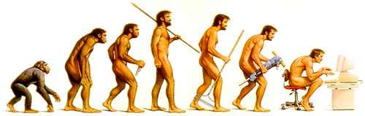




VERSION CONTROL
“Systems that record changes to a/set of file/s over time so that you can recall specific versions later” (Chacon&Straub, Pro Git)
5 key reasons to use version control
Document Evolution: Keep a historical, chronological record of your software's growth.
Time Travel: Revert to previous code states and revert or recover deleted files.
Chaos-Free Collaboration: Work on the same file with multiple people simultaneously.
Isolate Experiments: Test new features in separate branches without affecting the main project.
Project Auditing: You want to check when & who & last modified something that is causing a problem/issue.

Slide 4

VERSION CONTROL
“Systems that record changes to a/set of file/s over time so that you can recall specific versions later” (Chacon&Straub, Pro Git)
Myth vs. Reality
The Myth: "I can manage versions just fine by renaming my files (e.g., script_v2_final_fixed_DEFINITIVE.py)."
The Reality: Manual renaming leads to accidental overwrites, and makes it impossible to compare changes or know what actually changed between "final" and "final_v2".
The Value of Version Control (Git): Git tracks the content inside the files, not the file names, and remembers every single snapshot of its history behind the scenes.

Slide 5
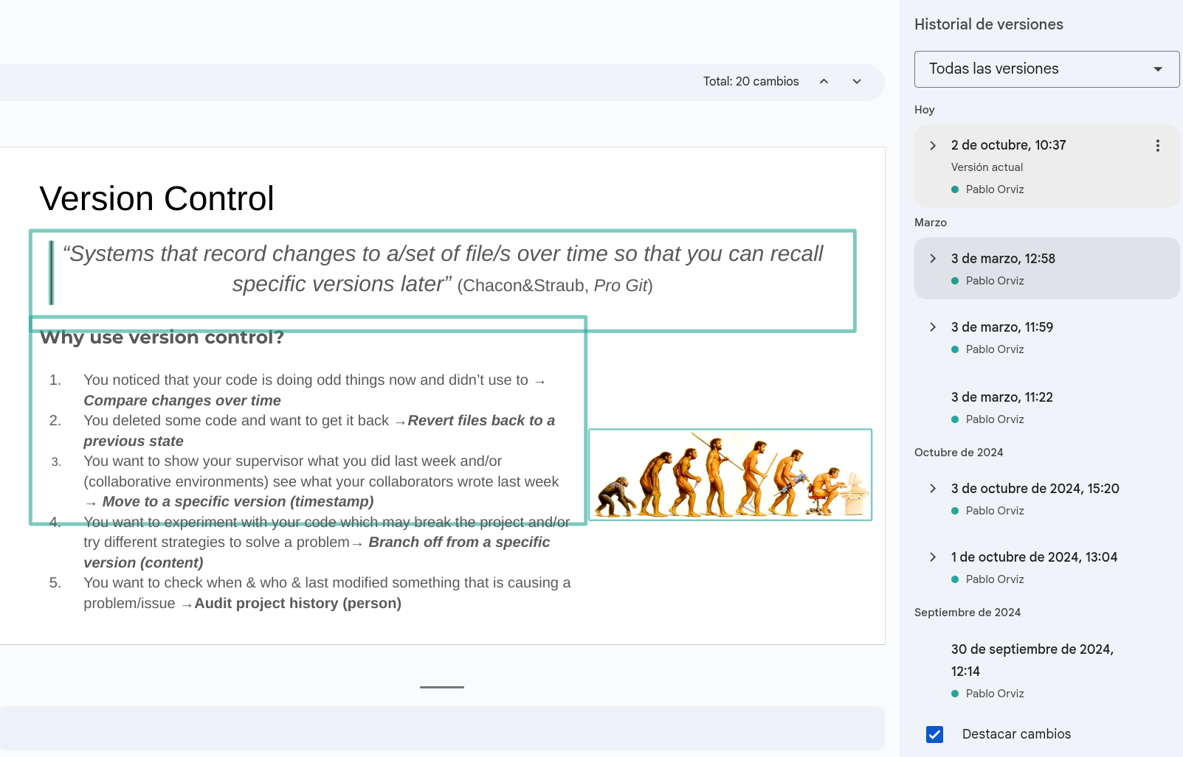
VERSION CONTROL
“Systems that record changes to a/set of file/s over time so that you can recall specific versions later” (Chacon&Straub, Pro Git)
Myth vs. Reality
The Myth: "Google Docs or OneDrive already save my versions automatically."
The Reality: Word processors don't understand code. They blindly merge changes and delete old history to save space.
The Value of Version Control (Git): A professional tool that guarantees absolute traceability, intentional manual commits, and the ability to safely collaborate without overwriting each other's work.
“The revisions for your file may occasionally be merged to save storage space” (Google Docs disclaimer)

Slide 6
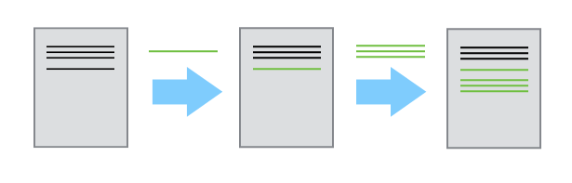
HOW VERSION CONTROL WORKS
Core concepts
The Repository (Repo, Project): the main database/folder where the VC System (VCS) tracks every single file/directory.
The History: single-source-of-truth that maintains a linear, chronological timeline with the evolution of the changes in the repository.
The Commit: snapshot of the content of your files/directories at a specific moment in time.
commit
commit
history of changes

Slide 7
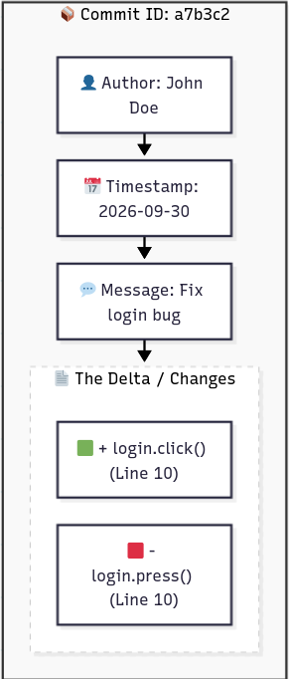
HOW VERSION CONTROL WORKS
Every Commit is bundled with crucial information (metadata)
Who made the change (Author)
When it was made (Timestamp)
Why it was made (Commit Message)
…
Core concept
The Delta: Instead of duplicating the whole folder, the system only records what was added (+) or removed (-).

Slide 8
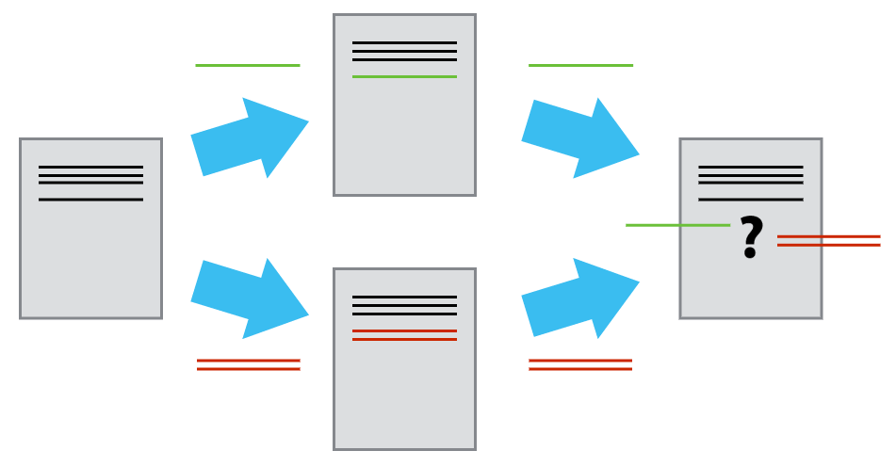
HOW VERSION CONTROL WORKS
Core concept: the Merge Conflict
The Scenario: Two developers modify the exact same line of the exact same file.
The Dilemma: When trying to combine both versions, the system cannot guess which change is the correct one.
The Halt: The system stops the merge, flags the file, and prevents any accidental overwrites.
The Resolution: A human must review the code, choose the final version, and manually clear the conflict.

Slide 9
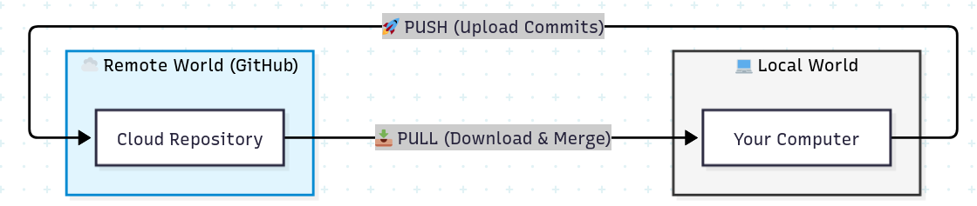
HOW VERSION CONTROL WORKS
The Two Worlds: Your project lives in two places
Local Repository: On your own computer (offline, private, fast).
Remote Repository: On a cloud server like GitHub (online, shared, backup).
Core concepts
The Push action (Uploading): Sending your local commits to the remote repository so your team can see them.
The Pull action (Downloading, Checkout): Fetching the latest changes from the remote repository and merging them into your computer.

Slide 10
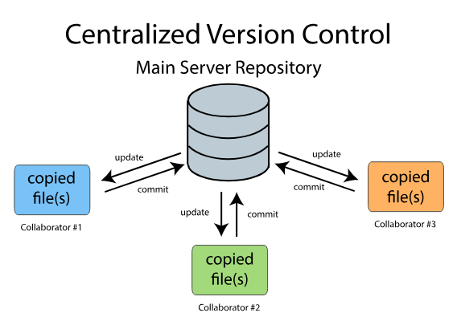
(BRIEF) HISTORY OF VERSION CONTROL SYSTEMS
The Centralized VCSs (The Server-Client Era)
Context: Born in the early 1980s (e.g., CVS, Subversion/SVN) to allow collaboration among geographically distributed teams.
Architecture: A single central server holds all versioned files. Clients "check out" only the specific files they need to work on.
Lock Mechanism: meaning often only one developer could edit a file at a time.
Pros: Huge step ahead from manual backups; clear visibility of who is doing what.
The Fatal Flaw (Cons):
  Single Point of Failure
    If the server goes down, no one can work.
    If the disk corrupts, the entire project history is lost forever.
  Slow Performance: Every operation requires a network connection to the remote server.

Slide 11
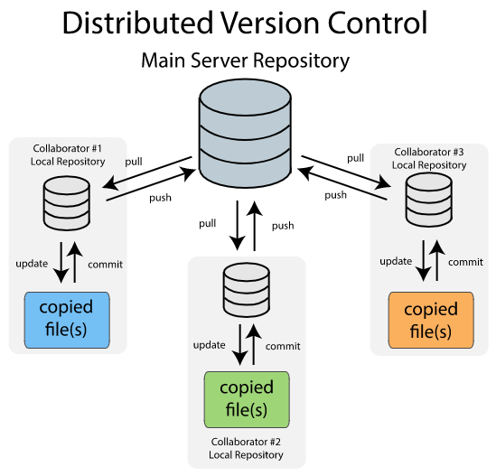
(BRIEF) HISTORY OF VERSION CONTROL SYSTEMS
The Distributed VCSs (Modern Collaboration)
The Paradigm Shift: Modern systems (e.g., Git, Mercurial, Fossil) remove the dependency on a single central server.
The Architecture: Every single client clones the entire repository, including the full historical timeline. Every repository is a complete backup.
Concurrent Work: No more file locking. Thanks to powerful merging tools, multiple authors can work on the exact same files simultaneously.
Pros:
  High Availability: If a server fails, the project can be fully restored from any developer's repository.
  Blazing Fast: All commits, history logs, and branches are processed locally on your computer (no internet needed).
Cons: None! (Almost... it requires a slightly steeper learning curve).

Slide 12
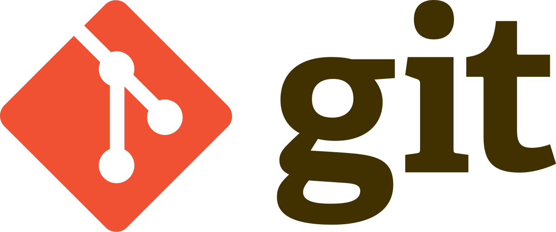
(BRIEF) HISTORY OF VERSION CONTROL SYSTEMS
The Birth of Git (Context & Lore)
The Timeline: By the early 2000s, older tools (RCS, CVS) became legacy systems due to limited capabilities.
The Catalyst (2005): Linus Torvalds created Git in just a few weeks as an open-source alternative to BitKeeper to manage the massive development of the Linux Kernel.
What does "Git" mean?: Torvalds famously provided multiple definitions in the project's README (depending on his mood): "Global Information Tracker", “random three-letter combination that is pronounceable”, "goddamn idiotic truckload of sh*t"
Current status: Today, Git is the undisputed global standard for software development.

Slide 13

(BRIEF) HISTORY OF VERSION CONTROL SYSTEMS
Alternatives to Git: Fossil
Designed for Different Scales: Git was made for the chaotic Linux Kernel (thousands of developers); Fossil for SQLite (smaller, high-trust team)
Software Scope: Git tracks code only (GitHub complements it). Fossil is "GitHub-in-a-box" (includes built-in wiki, tickets, and forum).
Storage & Data: Git uses a custom key/value store. Fossil uses a queryable SQLite database.
History of Versions’ Philosophy: Git allows rewriting history (rebase/squash) to look perfect. Fossil records history exactly as it happened.
Workflow: Git relies on manual pushes. Fossil uses automatic synchronization (autosync) by default

Slide 14
VCS IN A NUTSHELL (SUMMARY)
The Core Need: Manual file renaming (e.g., _final_v2) creates chaos. Version Control Systems (VCS) provide absolute tracking, history, and safety for your code.
Key Mechanisms:
  Commits: Intentional "snapshots" of your project, not silent background autosaves.
  Deltas: The system only records the difference: lines added (+) or removed (-), keeping it lightweight.
The Evolution: from Centralized systems (high risk of server failure, slow remote operations) to modern Distributed systems (every machine holds a full backup, ultra-fast local operations).
Collaboration relies on moving changes between your Local Repository (your computer) and the Remote Repository (the cloud, e.g. GitHub) using Push and Pull.
Different Philosophies:
  Git (follows: classic Unix design principle: "Do one thing and do it well."): The de-facto tool for control version based on its powerful, modular code-tracker designed for massive, chaotic projects that relies on external platforms like GitHub,
  Fossil (follows: Cathedral Philosophy) An all-in-one "GitHub-in-a-box" database designed for small teams, prioritizing an unchangeable history.

Slide 15
COURSE CONTENTS
01
VERSION CONTROL
02
COLLABORATION PLATFORM: GITHUB
03
HANDS-ON GIT

Slide 16
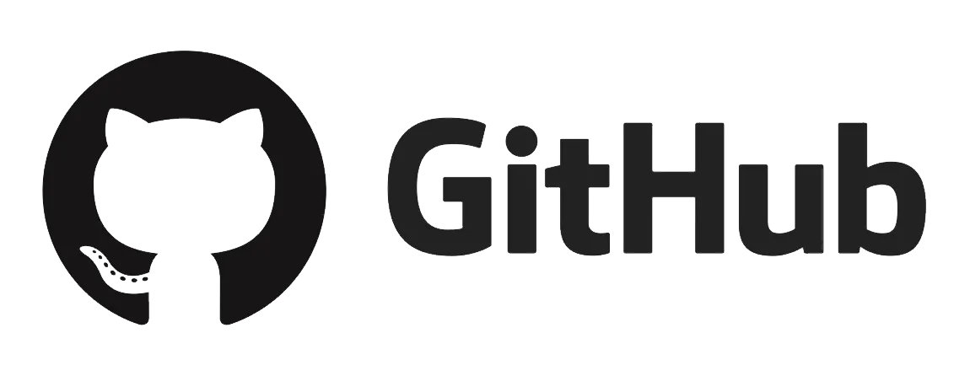
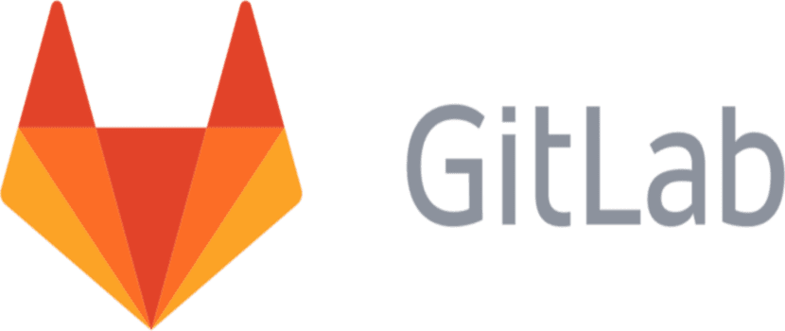
THE RISE OF SOCIAL CODING
The Shift in Collaboration: Modern platforms (GitHub, GitLab) transformed code hosting into a global social network for developers.
The Core Impact: They shifted the focus from central organizations to individual developers, democratizing peer production.
Before Social Coding | With Social Coding
Rigid Hierarchy: Strict separation between code producers and consumers. | Fluid Framework: Consumers are producers. Anyone can contribute.
High Barrier: Only professional developers or core maintainers could easily contribute. | Low Barrier: Forking and Pull Requests made contributing accessible to everyone.
Centralized Control: Heavy gatekeeping on what gets built and merged. | Decentralized Innovation: The community drives the evolution of the software.
GitHub didn’t just host code; it became the world's resume for developers and the town square for open source.

Slide 17
WHAT GITHUB ADDS TO GIT
Collaboration & Social Features:
Pull Requests (PRs): The ultimate tool for code review, discussion, and testing before merging code.
Forks: One-click cloning of any public repository into your own account to start experimenting or contributing.
Documentation & Hosting:
• GitHub Pages: Turn any repository into a public website directly from your code
• Wikis: A built-in, separate section for long-form documentation, guides, and developer manuals.
Access & Collaboration Models:
• Public vs. Private Repositories: Public repos are open to the world for open-source collaboration.
Project Management Tools:
Issues & Discussions: Integrated bug tracking, feature requests, and forum-style team communication.
GitHub Projects: Kanban-style boards (like Trello) to plan milestones and track team progress.
Automation & Operations:
GitHub Actions (CI/CD): Automatically test, build, and deploy your code every time you make a change.
Security & Insights: Automatic alerts for vulnerable dependencies and detailed repository analytics.

Slide 18
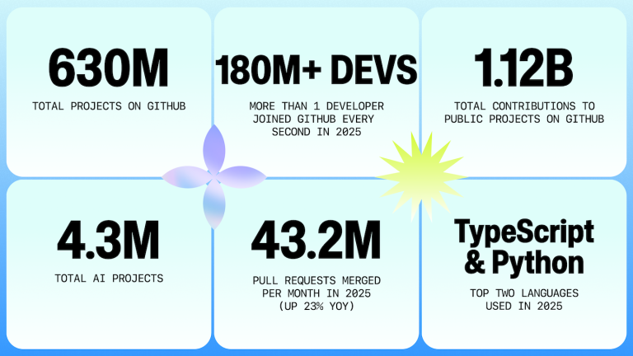
GITHUB IN NUMBERS
The Developer Tsunami: GitHub now hosts over 180 million developers globally.
Steady Growth: More than 36 million new developers joined in a single year — which averages to ~1 new developer signing up every single second.
De-facto Platform for Code Hosting: The platform hosts 630 million total repositories, with 121 million new ones created just last year.
Open Source Dominance: 63% of all repositories on the platform are public or open-source.
Further details in the Octoverse 2025 report.

Slide 19

SUCCESS SCIENCE STORIES IN GITHUB
COVID-19 Genomics & Tracking
The Challenge: Mapping the global spread of a pandemic in absolute real-time.
GitHub impact: the Johns Hopkins University used a public GitHub repository to host the daily data. It became the world's single source of truth for governments, researchers, and media worldwide.
https://doi.org/10.1016/S1473-3099(20)30120-1
The Event Horizon Telescope (First Black Hole Image)
The Challenge: Processing petabytes of scattered data from telescopes all over the world.
GitHub impact: Hundreds of international scientists collaborated on the NumPy and SciPy Python libraries hosted on GitHub to build the imaging algorithms.
https://doi.org/10.3847/2041-8213/ab0e85

Slide 20
GITLAB AS AN ALTERNATIVE TO GITHUB
Feature | GitHub 🌐 | GitLab 🦊
Primary Focus | Social coding, community size, and open-source hosting [2.1]. | Enterprise DevOps, CI/CD automation, and project governance.
CI/CD Integration | GitHub Actions (powerful, modular, community-driven). | Built-in CI/CD (industry pioneer, native, highly stable).
Extensibility | Third-party Apps: You pick extensions from a vast Marketplace. | All-in-One: Most features are native and built into the platform.
Self-Hosting | Available (GitHub Enterprise), but complex and cloud-oriented. | Excellent self-hosting: Easy to deploy on private company servers.
Open Source Model | Proprietary platform owned by Microsoft. | Open-Core (community edition code is public).

Slide 21
COURSE CONTENTS
01
VERSION CONTROL
02
COLLABORATION PLATFORM: GITHUB
03
HANDS-ON GIT

Slide 22
GETTING STARTED WITH GIT
Our approach in this course: Command-line (CLI) over Graphical Interfaces (GUI)
The GUI limitations:
GUIs implement only a subset of Git features (e.g. GitHub Desktop).
With GUIs you won’t understand the real Git workflow.
GUISs tend to hinder logs and useful debug/troubleshooting information.
CLIs enable automated workflows.
The rule of thumb: If you master the CLI, GUIs hold no secrets. The opposite is not true.
Where to Access the Git CLI:
Local Option (the Preferred): Install Git client directly on your machine: System terminal or IDEs such as VSCode.
Master’s Data Science Hub (the Fastest for today’s course): Web-based Git CLI
Cloud options: GitHub CodeSpaces provides a VSCode-like environment (with terminal included).
Prerequisites: a GitHub Account is required. Create one at https://github.com/ if you haven’t already.

Slide 23
GETTING STARTED WITH GIT
About the Hands-on tutorial
We will follow the tutorial from the GitHub repository at https://github.com/orviz/git-github-tutorial-master-datascience/blob/master/README.md
As student, you could copy/paste the commands but typing the git commands is recommended as it builds muscle memory

Slide 24

Gracias por su atención

